Slide 1
Functional enrichment analysis of high-throughput omics data
Ludwig Geistlinger Jun 19, 2020
School of Public Health
City University of New York

Slide 2
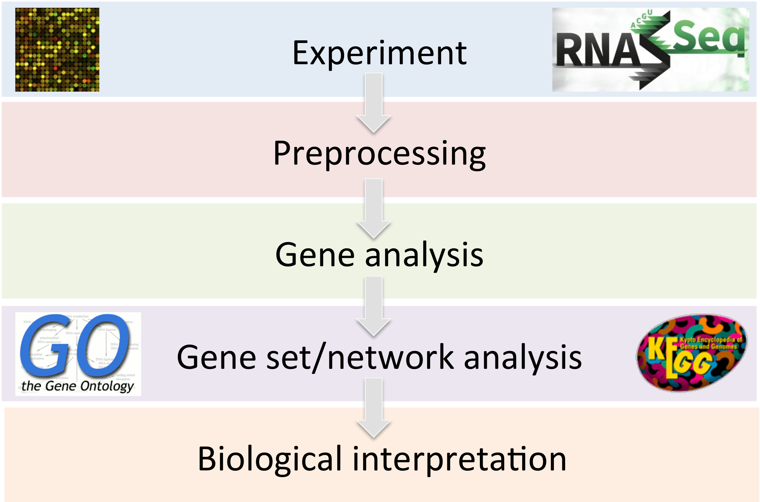
Gene expression data analysis

Slide 3
GSA theory: null hypothesis
Goeman and Bühlmann. Analyzing gene expression data in terms of gene sets: methodological issues. Bioinformatics, 23(8):980-7, 2007.
Competitive:
The genes in the set of interest are at most as often DE as the genes not in the set
Self-contained:
No genes in the set of interest are DE
3

Slide 4
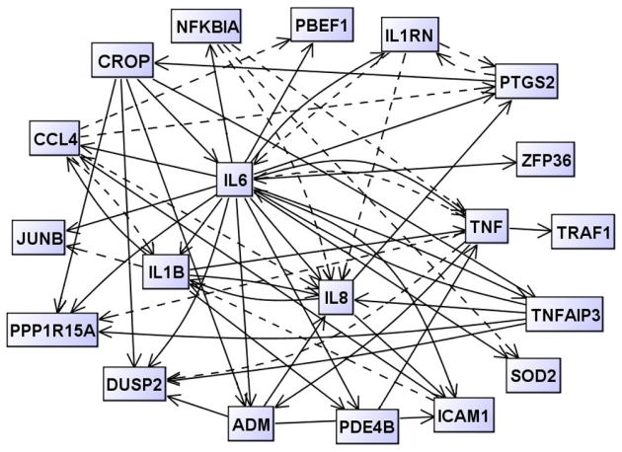
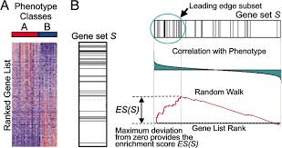
Khatri et al. Ten years of pathway analysis: current approaches and outstanding challenges. PLoS Comput Biol 8(2):1002375, 2012.
1st Generation
(overrepresentation of de genes)
3rd Generation
(integration of network topology)
 | DE | Not DE
In GS | m_{GD} | m_{GD}c
Not in GS | m_{G}c_{D} | m_{G}c_{D}c
2nd Generation
(functional class scoring on all genes)
4

Slide 5
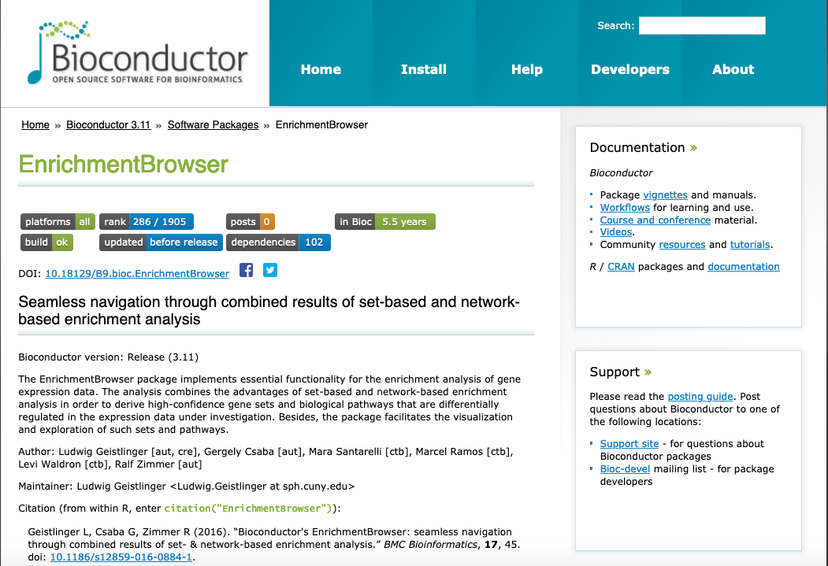

Slide 6
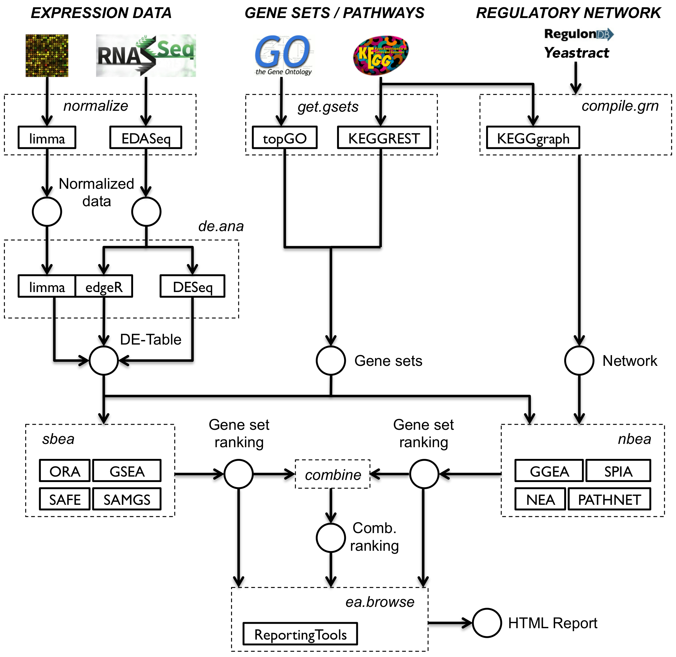

Slide 7
Currently available methods
> EnrichmentBrowser::sbeaMethods()
[1] "ora" "safe" "gsea" "samgs" "ebm"
[6] "mgsa" "gsa" "padog" "globaltest" "roast"
[11] "camera" "gsva"
> EnrichmentBrowser::nbeaMethods()
[1] "ggea" "spia" "pathnet" "degraph" "topogsa"
[6] "ganpa" "cepa" "netgsa" "nea"
7

Slide 8
Enrichment analysis in practice
GO/KEGG overrepresentation
Dozens of methods published, partly available (in BioC)
Development of additional methods ongoing
Lack of standards for method evaluation
No „best“ method
Existing methods have never been compared consistently
8

Slide 9
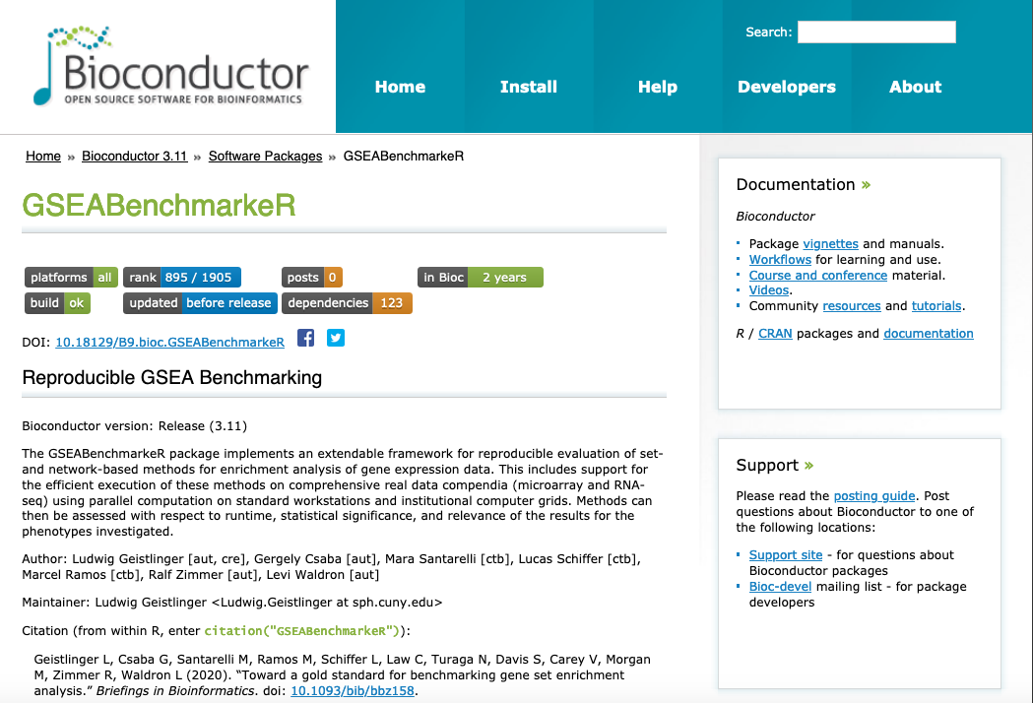

Slide 10
Geistlinger et al. Toward a gold standard for benchmarking gene set enrichment analysis. Brief Bioinform, 2020. doi: 10.1093/bib/bbz158
Efficient parallel execution
Representative and extendable collection of 20 methods
Comprehensive real data compendium
Microarray & RNA-seq
Investigating human diseases (mostly cancer)
Systematic and reproducible assessment of
Runtime
Statistical significance
Phenotype relevance (using a priori defined relevance rankings)
10

Slide 11
Hands-on practice

Slide 12
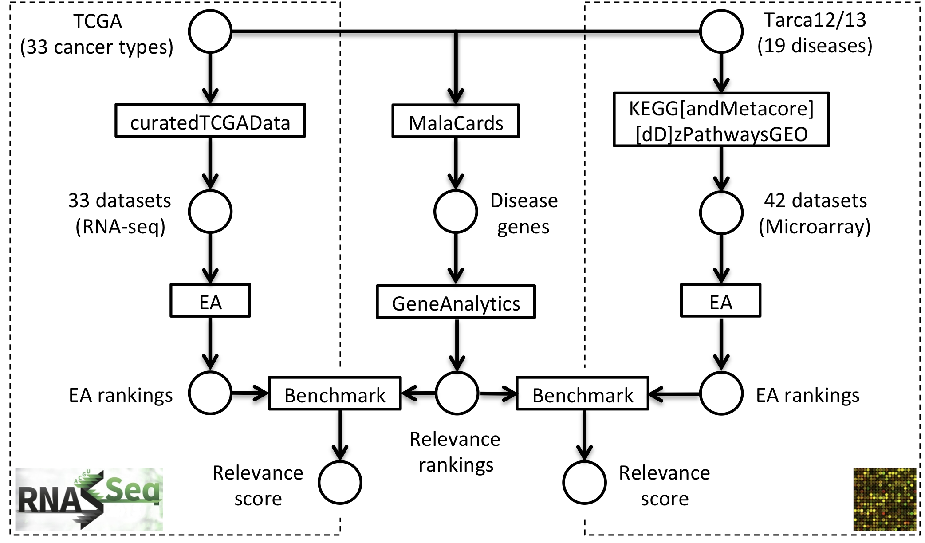
GSEA Benchmark panel

Slide 13
GSEA Benchmark panel

Slide 14
GSEA Benchmark panel

Slide 15
GSA Benchmarking in action ...

Slide 16
> EnrichmentBrowser::sbeaMethods()
 | METHOD | NAME | AUTHOR | YEAR | CITATIONS Google, 07/2018
1 | ORA | OverRepresentation Analysis
2 | GLOBALTEST | GLOBAL TESTing of groups of genes | Goeman et al. | 2004 | 937
3 | GSEA | Gene Set Enrichment Analysis | Subramanian et al. | 2005 | 14 403
4 | SAFE | Significance Analysis of Function & Expression | Barry et al. | 2005 | 333
5 | GSA | Gene Set Analysis | Efron & Tibshirani | 2007 | 768
6 | SAMGS | Sig. Ana. of Microarrays on Gene Sets | Dinu et al. | 2007 | 258
7 | ROAST | ROtAtion gene Set Test | Wu et al. | 2010 | 209
8 | CAMERA | Correlation Adjusted MEan Rank gs test | Wu et al. | 2012 | 185
9 | PADOG | Path. Ana. with Down-weighting of Ovlp. Genes | Tarca et al. | 2012 | 60
10 | GSVA | Gene Set Variation Analysis | Hänzelmann et al. | 2013 | 293

Slide 17
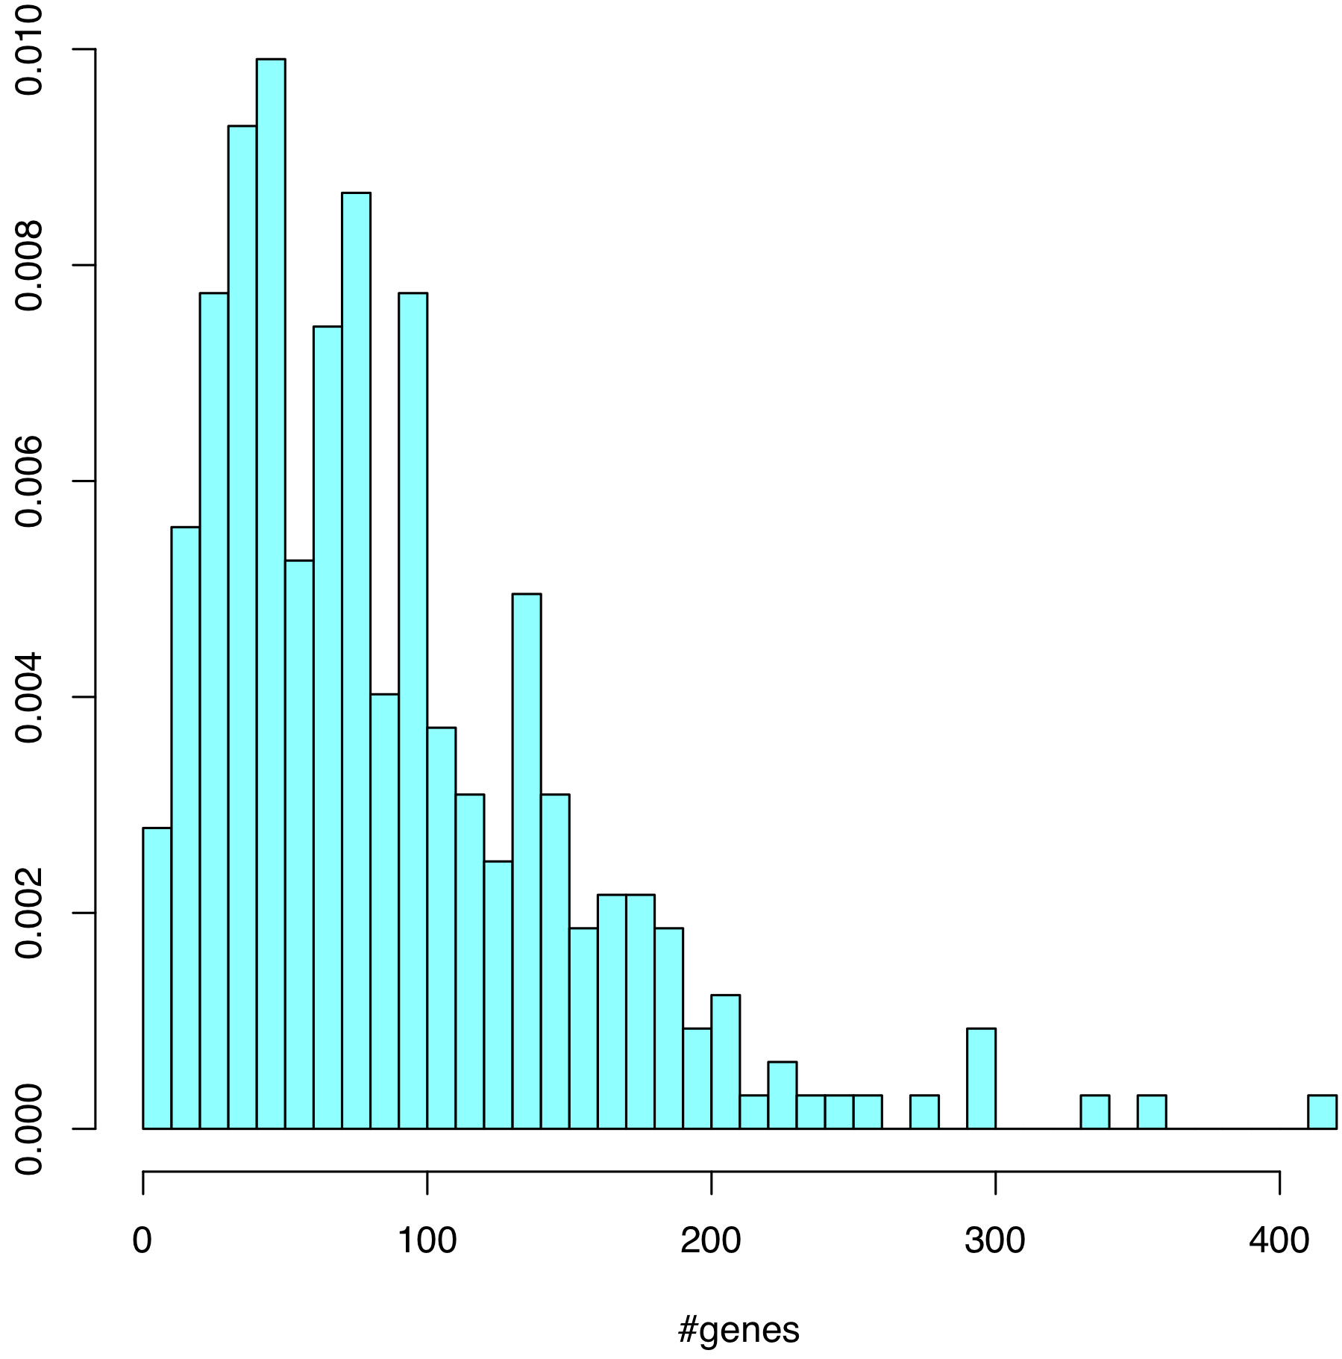
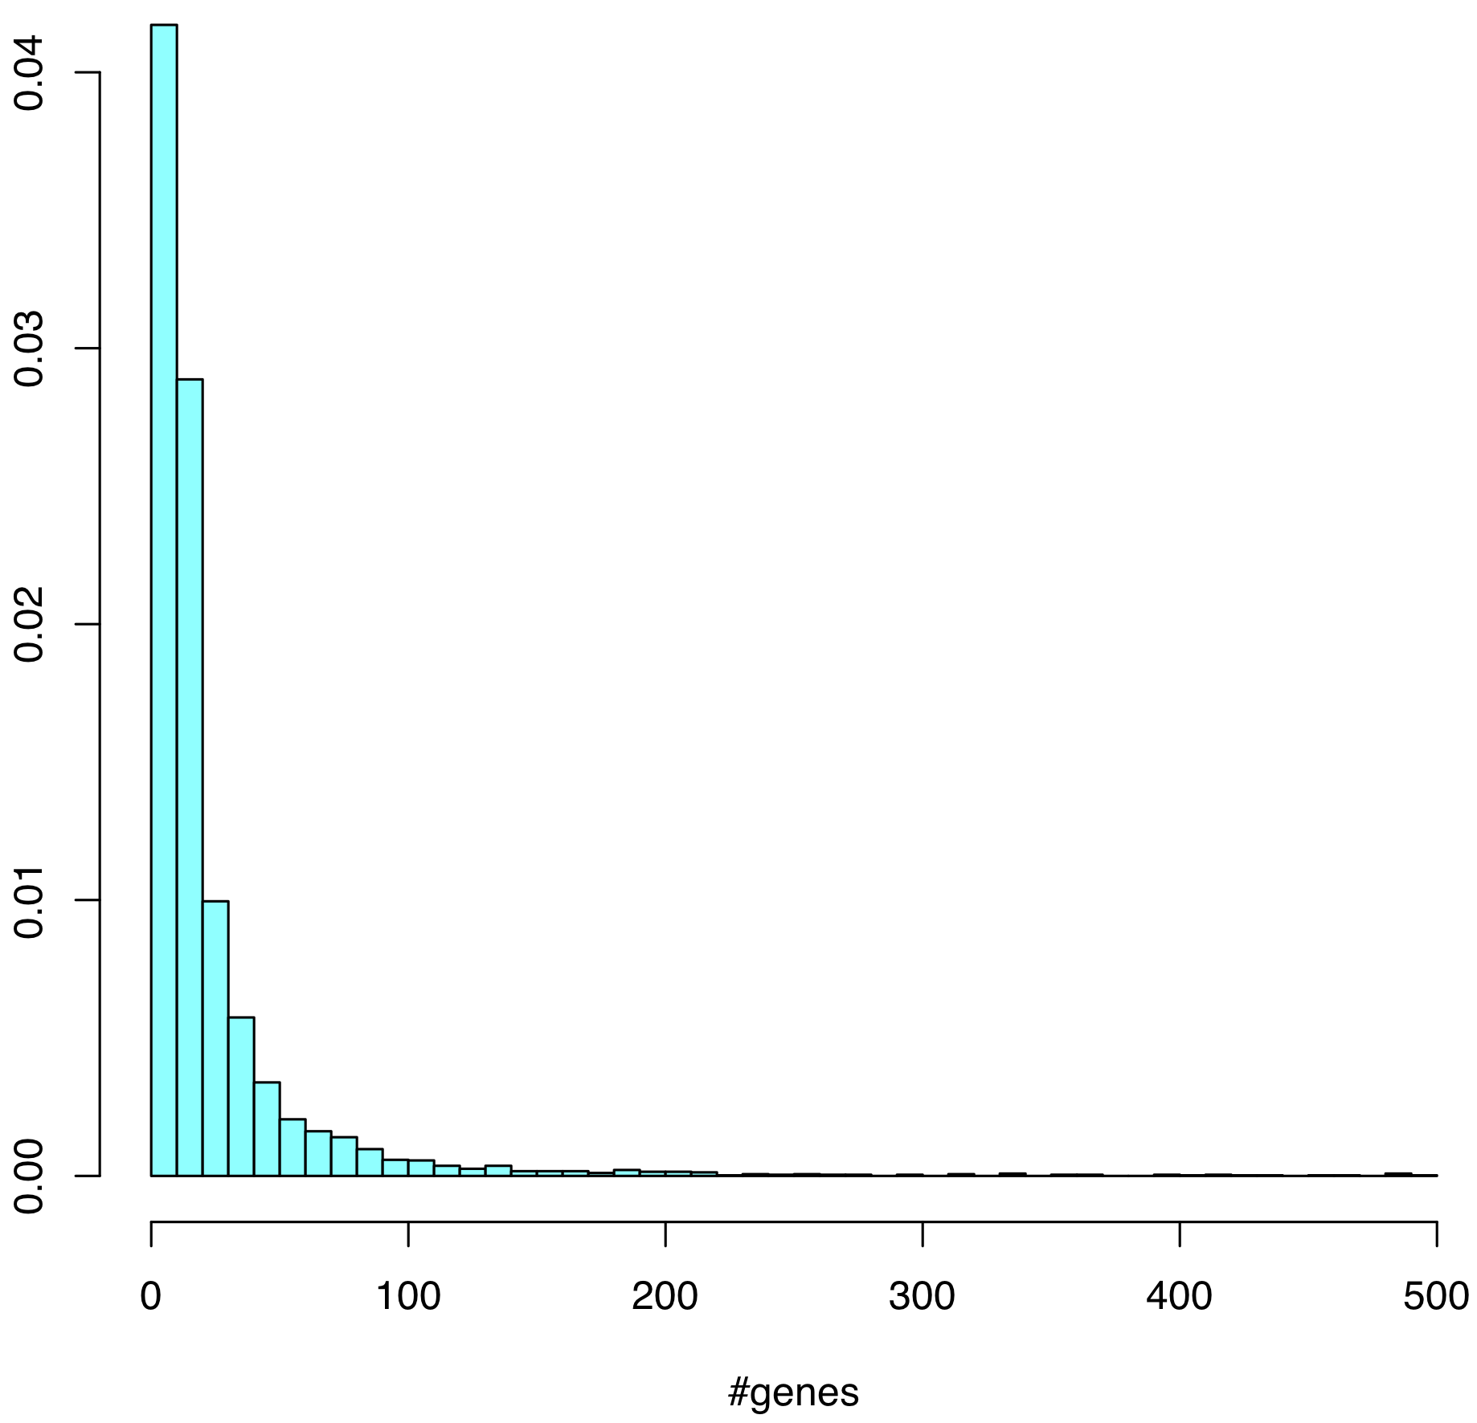
Gene set size (min = 5, max = 500)
KEGG
(N = 323)
GO_BP
(N = 4,631)
median = 72
median = 11
17

Slide 18
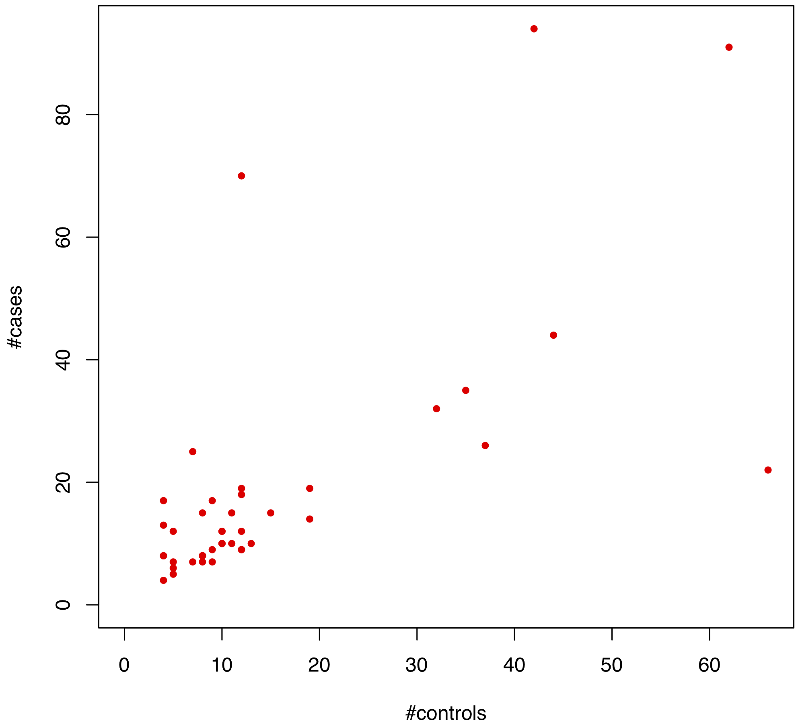
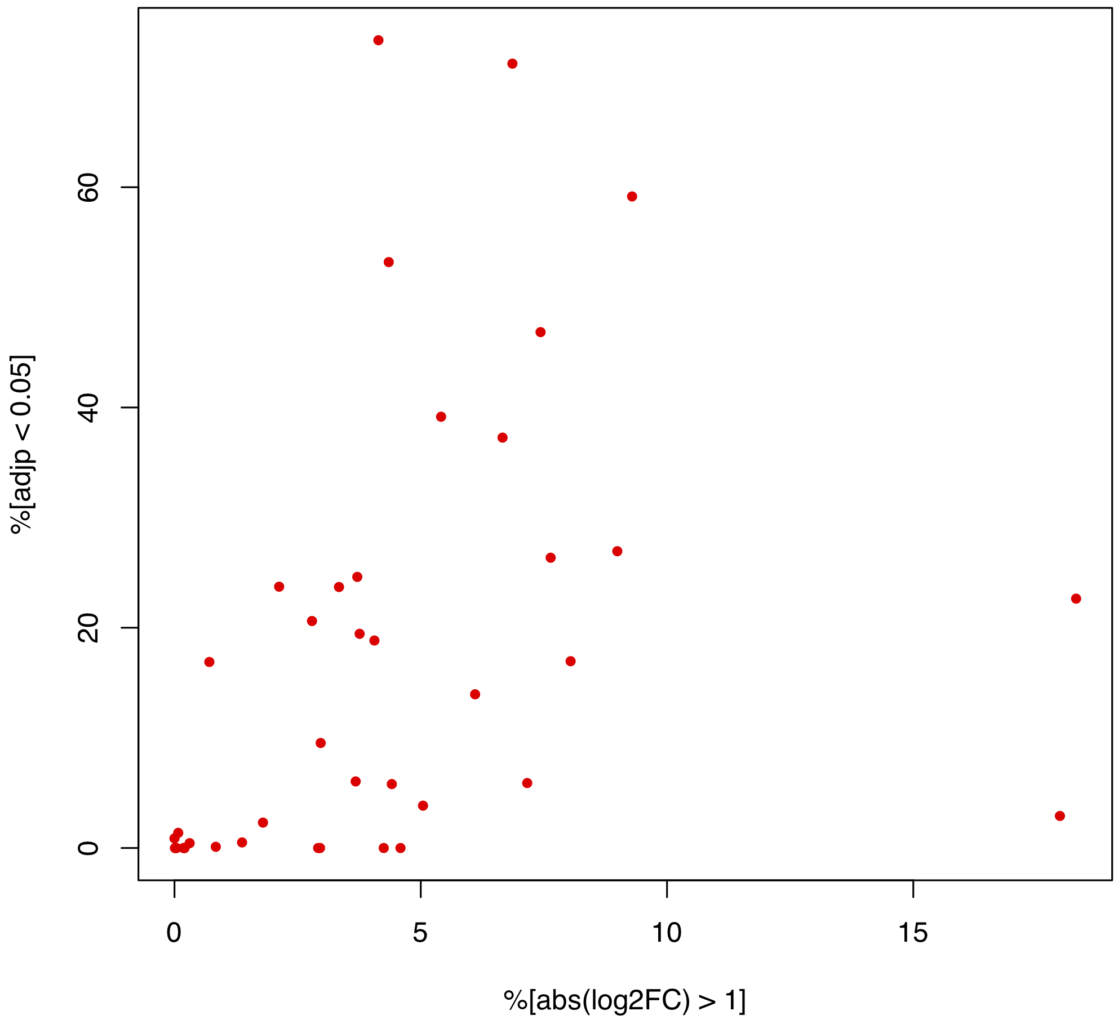
Expression data (Microarray compendium, N = 42)
#samples
%DE
18

Slide 19
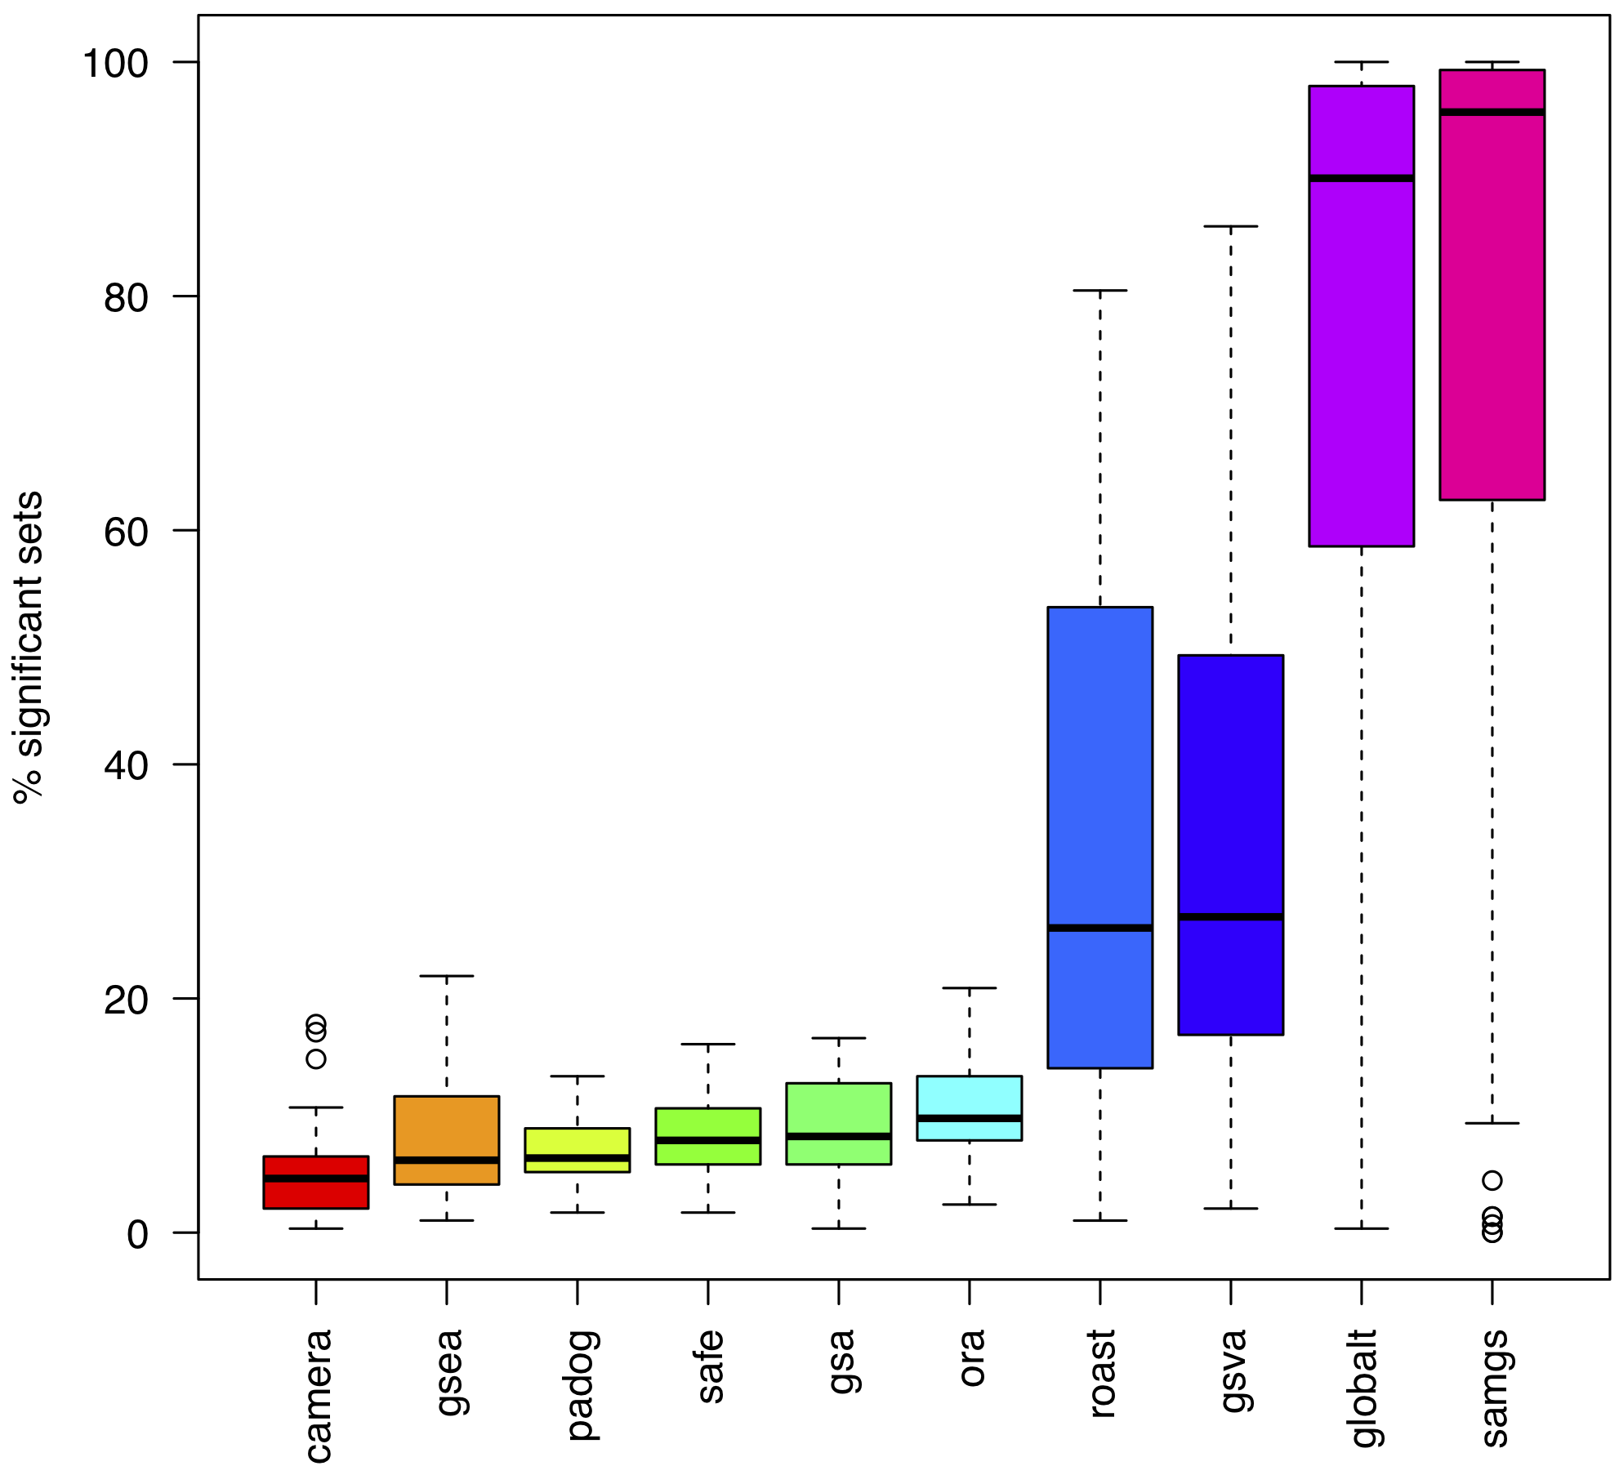
Statistical significance
Competitive
Self-contained
(nominal p-values)

Slide 20
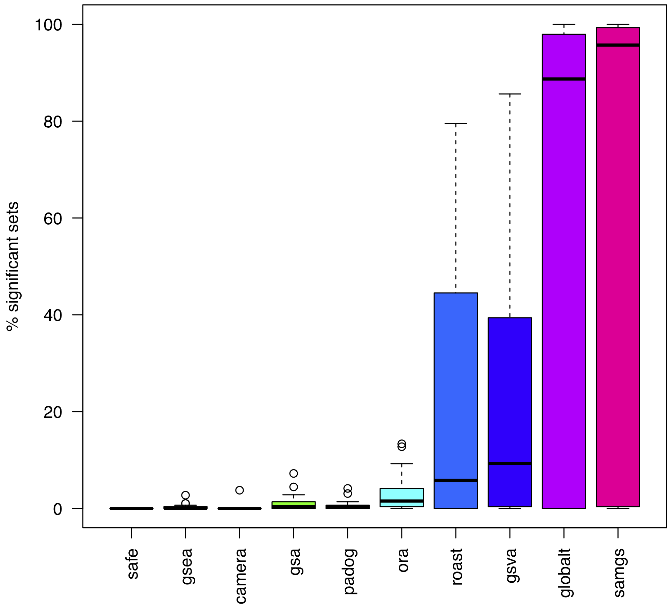
Statistical significance
Competitive
Self-contained
(adjusted p-values)

Slide 21
Assessing phenotype relevance
Typical approach:
Cherry-pick from enriched gene sets those with link to phenotype
Conclude that there is relevance for the phenotype investigated
An unbiased approach:
A priori investigate phenotype relevance of all gene sets
Quantify relevance accumulated along the gene set ranking
➔ How to score phenotype relevance of a gene set?
21

Slide 22
How to score phenotype relevance of a gene set?
MalaCards:
Human disease database (“GeneCards for maladies“)
Scores genes for disease relevance based on experimental evidence & co-citation in the literature
GeneAnalytics:
Integrative gene list analysis tool (part of the GeneCards Suite)
Summarizes per-gene relevance across GO & KEGG gene sets
22

Slide 23
Similarity between GSEA & MalaCards ranking
Sum over all gene sets
Σ w(i) S_{d}(i)
Weight (GSEA ranking)
Relevance score (MalaCards ranking)
Pathway | w
Cell cycle | 0.9967
Ribosome | 0.9933
Purine metabolism | 0.99
Pyrimidine metabolism | 0.9867
Pancreatic cancer | 0.9833
Glycolysis | 0.98
Pathway | S_{d}
Pancreatic cancer | 122.8
Pathways in Cancer | 105.6
P53 signaling | 92.7
Cell cycle | 89.4
Thyroid cancer | 81.5
Glycolysis | 76.3

Slide 24
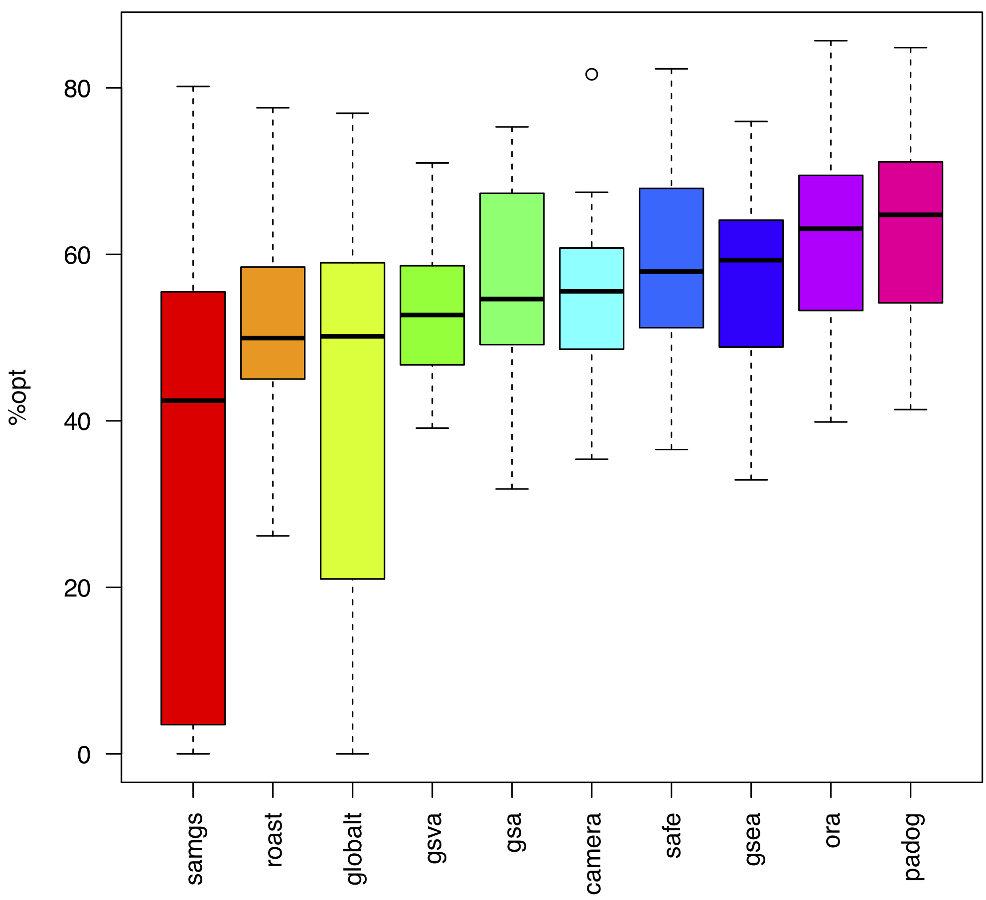
Phenotype relevance
Self-contained
Competitive

Slide 25
Conclusion
http://bioconductor.org/packages/GSEABenchmarkeR
systematic benchmarking of existing and future EA methods
for real datasets
Self-contained GSA tests:
frequently render all gene sets significant
even random gene sets (gene set size dependency)
Competitive GSA tests:
tend to rank phenotype-relevant gene sets systematically higher
no gene set might be considered significant after multiple testing correction
work-in-progress: RNA-seq data & network-based methods
25

Slide 26






Acknowledgements
Mara Santarelli
Gergely Csaba
Ralf Zimmer
Lucas Schiffer
Marcel Ramos
Levi Waldron
26

Slide 27
Thank you!

Slide 28
Currently available methods
> EnrichmentBrowser::sbeaMethods()
[1] "ora" "safe" "gsea" "samgs" "ebm"
[6] "mgsa" "gsa" "padog" "globaltest" "roast"
[11] "camera" "gsva"
> EnrichmentBrowser::nbeaMethods()
[1] "ggea" "spia" "pathnet" "degraph" "topogsa"
[6] "ganpa" "cepa" "netgsa" "nea"
28

Slide 30
Benchmark criteria & issues
Applicability
Runtime & data type (microarray / RNA-seq)
Statistical significance
Type I error inflation & permutation p-values
Phenotype relevance
Ad hoc biological reasoning
Reproducibility and extensibility
Reproduce existing assessments for additional methods
30

Slide 31
Essential functions
Expression data
BiocFileCache
edat <- loadEData("geo2kegg") Microarray compendium
edat <- loadEData("tcga") RNA-seq compendium
edat <- loadEData("/path/to/edata“) User-defined data
Execution of selected DE and EA methods
BiocParallel
edat <- runDE(edat, de.method)
res <- runEA(edat, methods, gs)
Benchmarking
sig.sets <- evalNrSigSets(res, alpha, padj)
typeI <- evalTypeIError(res, alpha, perm)
rel <- evalRelevance(res, rel.ranks, data2pheno)

Slide 32
Statistical significance (nominal p-values)
> kegg.gs <- getGenesets(org="hsa", db="kegg")
> res <- runEA(edat, methods=sbeaMethods(), gs=kegg.gs)
> sig.sets <- evalNrSigSets(res, alpha=0.05, padj="none")
> bpPlot(sig.sets, what="sig.sets")
32

Slide 33
Statistical significance (adjusted p-values)
> sig.sets <- evalNrSigSets(res, alpha=0.05, padj="BH")
> bpPlot(sig.sets, what="sig.sets")
33

Slide 34
Application in a controlled setup
Golub et al. Molecular classification of cancer: class discovery and class prediction by gene expression monitoring. Science, 286(5439):531-7, 1999.
Random sample labels:
Shuffle sample labels (case vs. control) 1000x
In each permutation: #gene sets with p < 0.05 (= type I error rate)
34

Slide 35
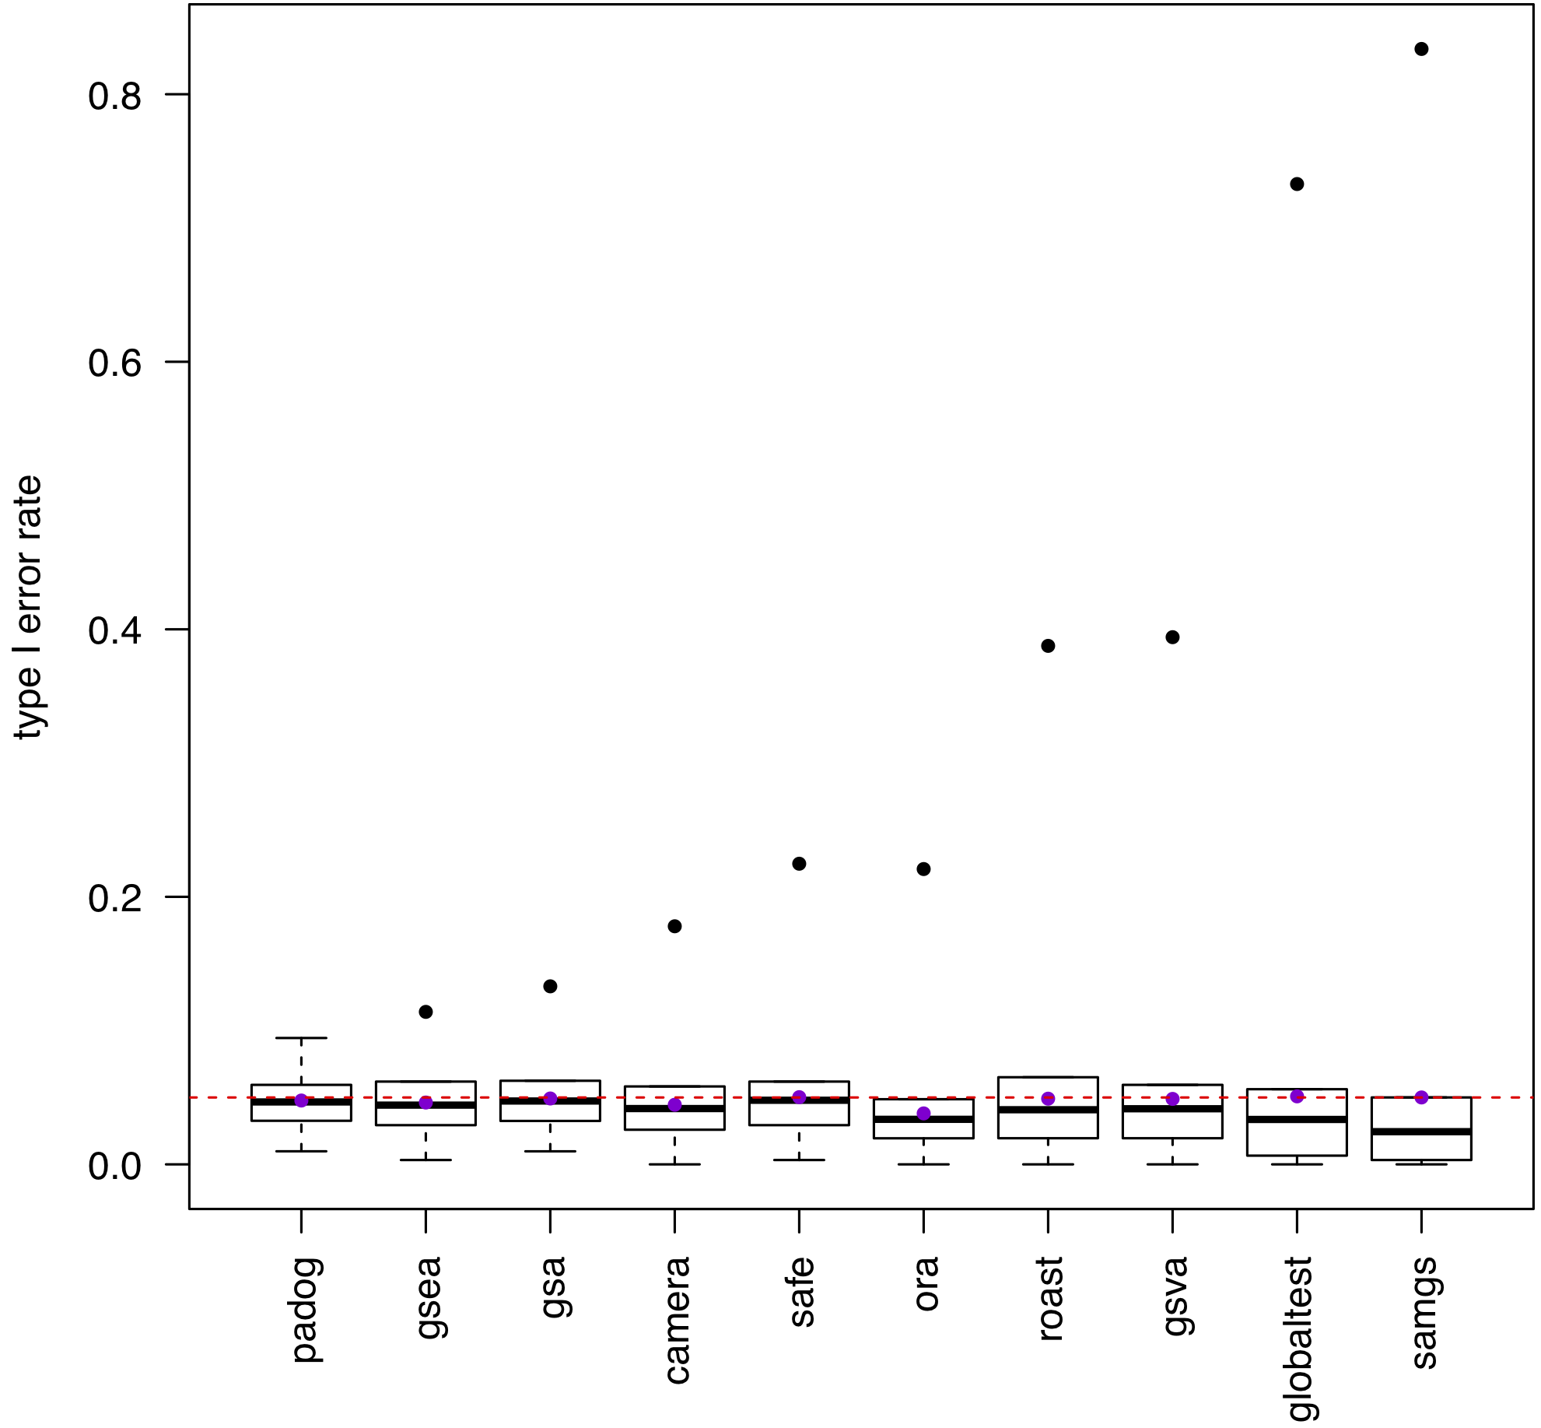
Statistical significance
(Type I error rate)
0.05

Slide 36
Application in a controlled setup
Golub et al. Molecular classification of cancer: class discovery and class prediction by gene expression monitoring. Science, 286(5439):531-7, 1999.
Random sample labels:
Shuffle sample labels (case vs. control) 1000x
In each permutation: #gene sets with p < 0.05 (= type I error rate)
Random gene sets:
100 random gene sets of defined size s in {5, 10, ... , 250, 500}
Are methods affected by gene set size?
36

Slide 37
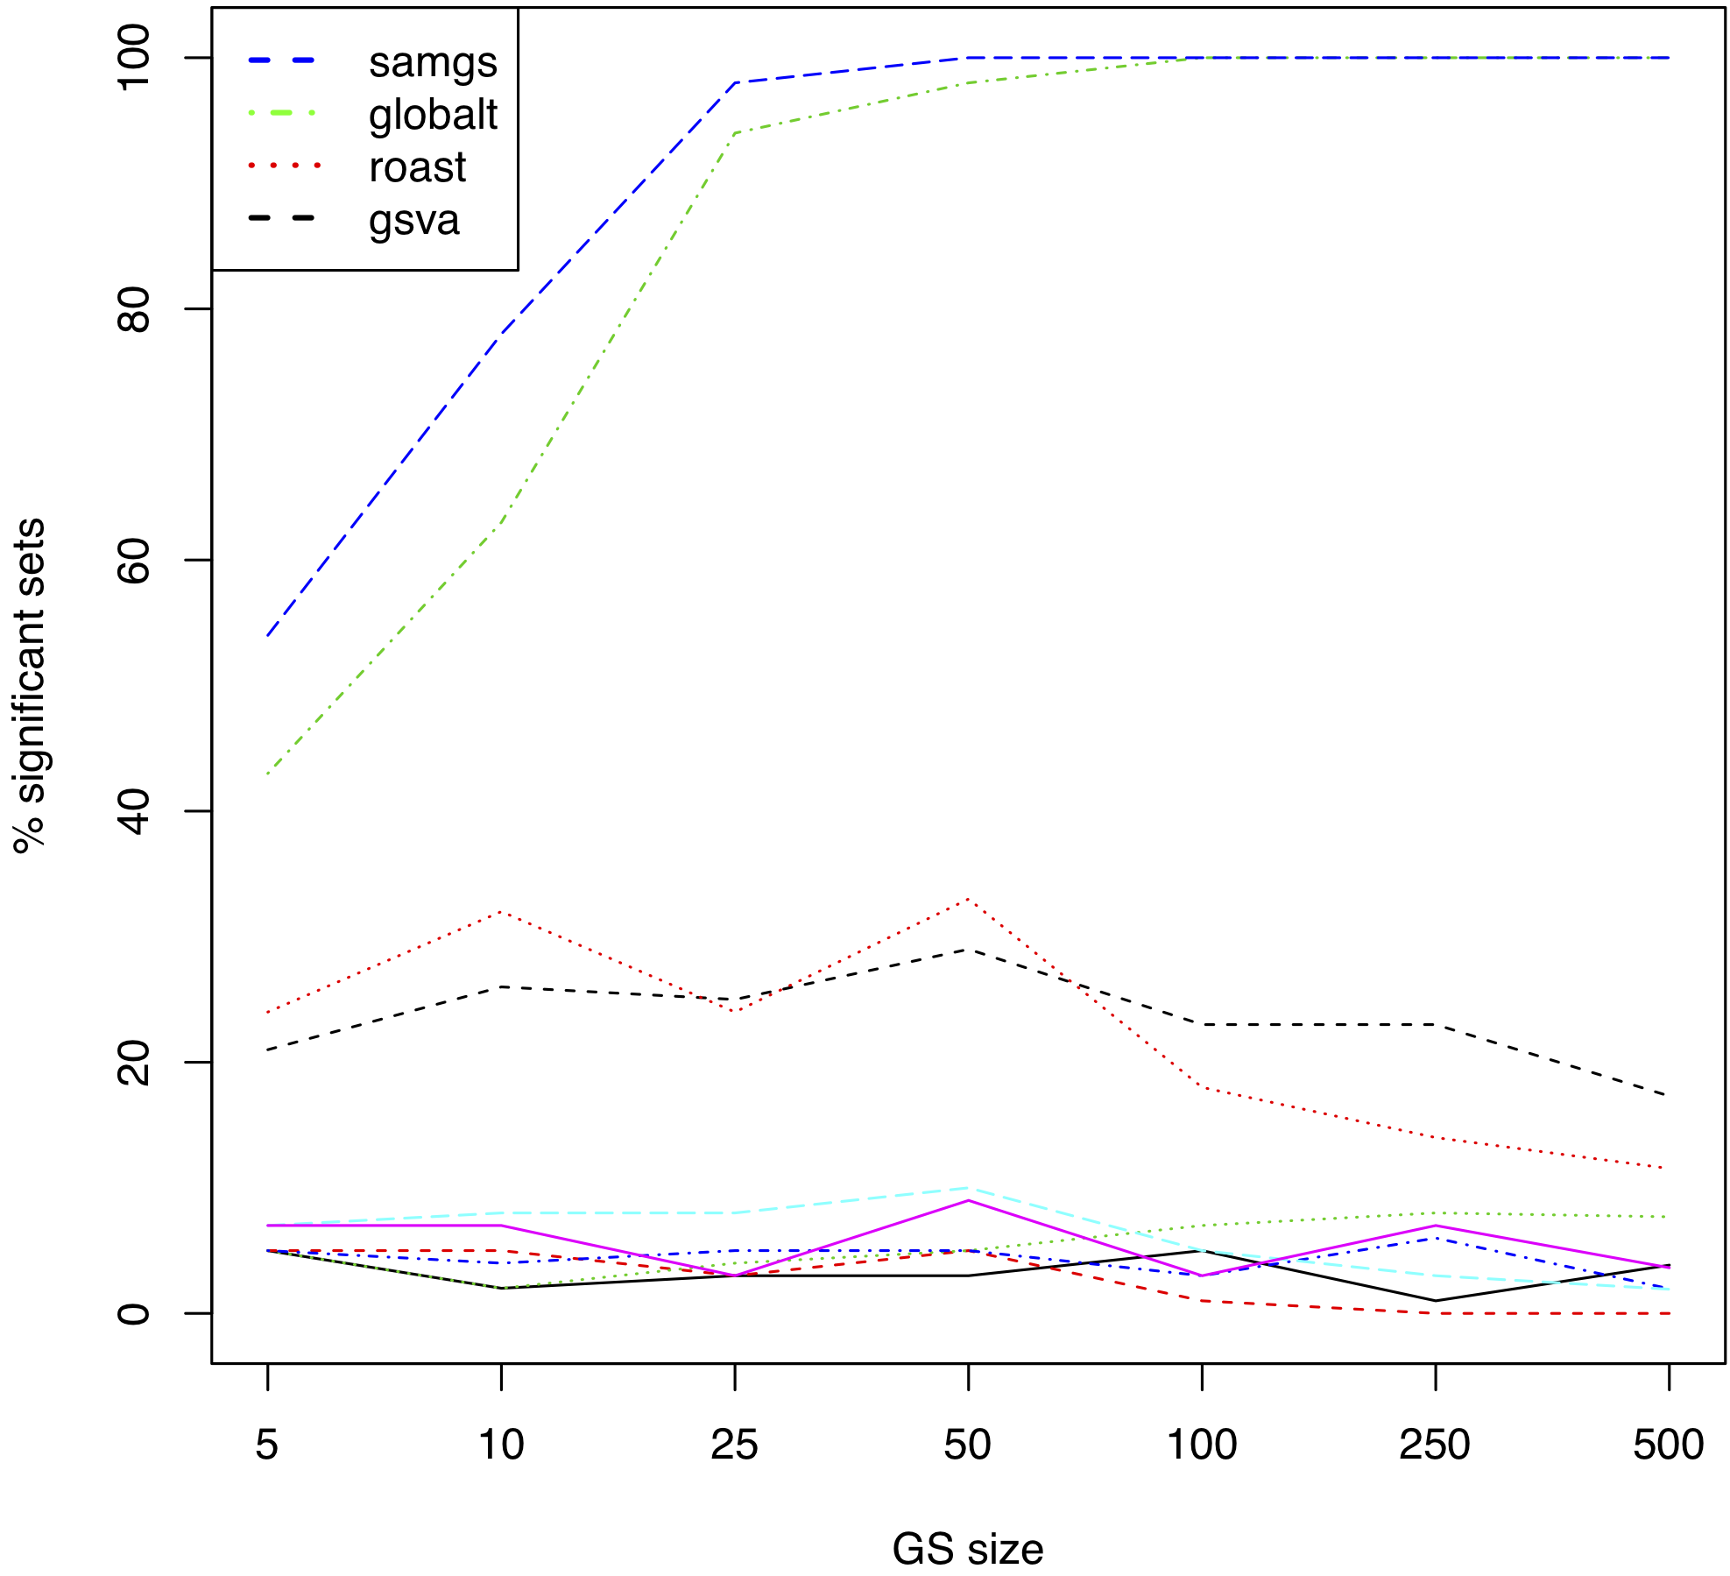
Random gene sets

Slide 38
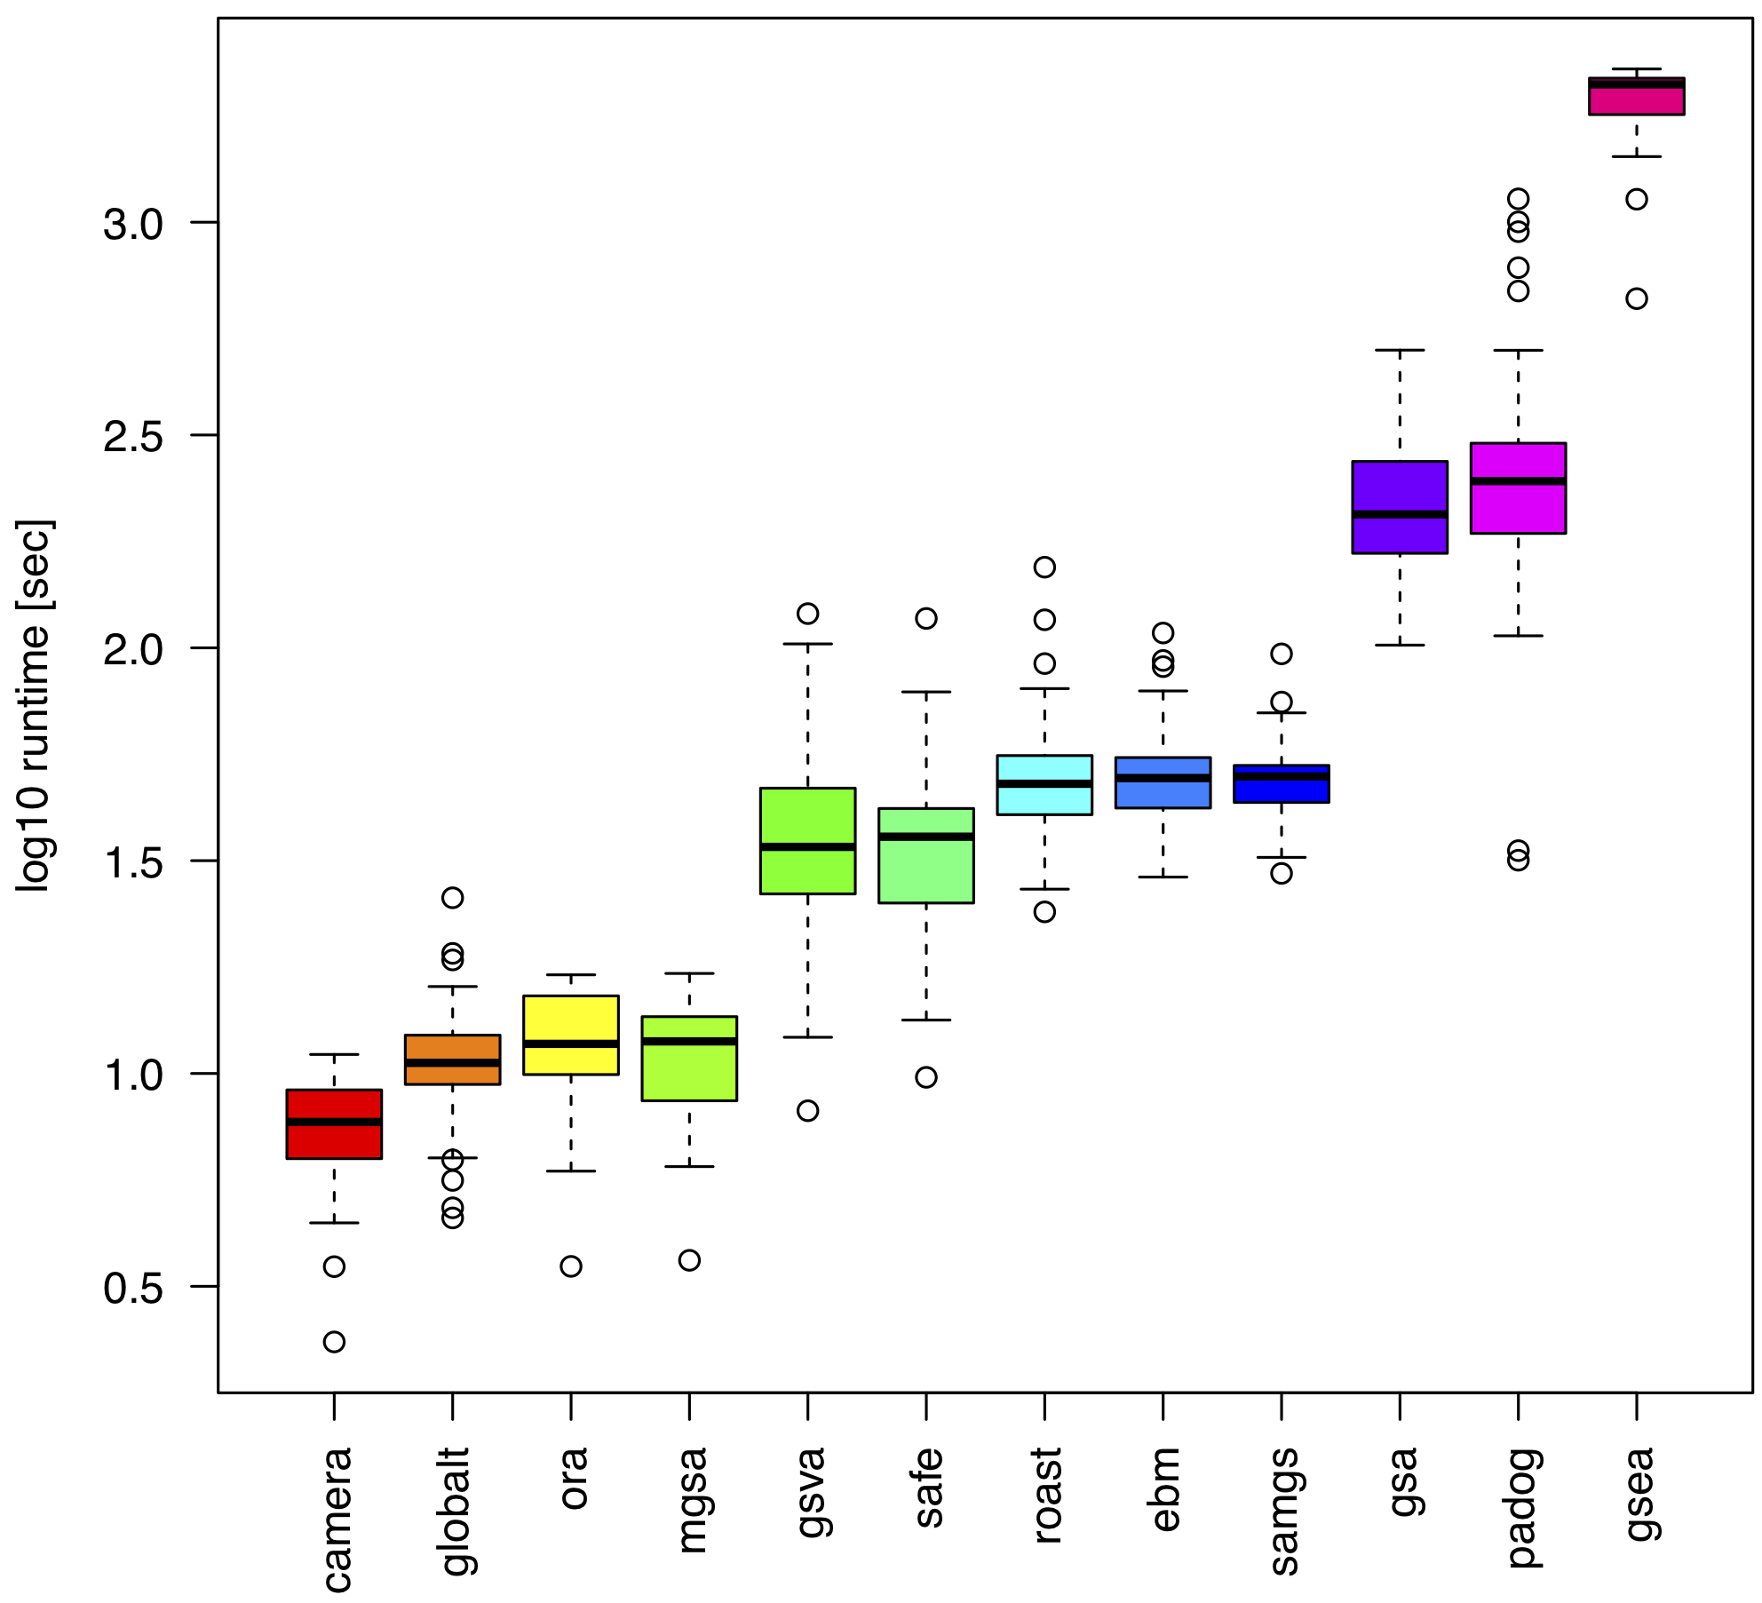
Runtime
15 min 40 sec
1 min 40 sec
10 sec
Intel Xeon 2.7 GHz

Slide 39
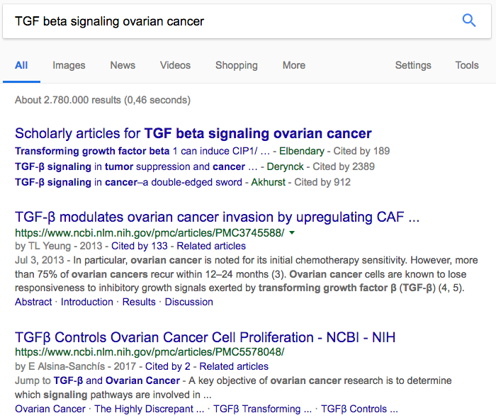

Slide 40
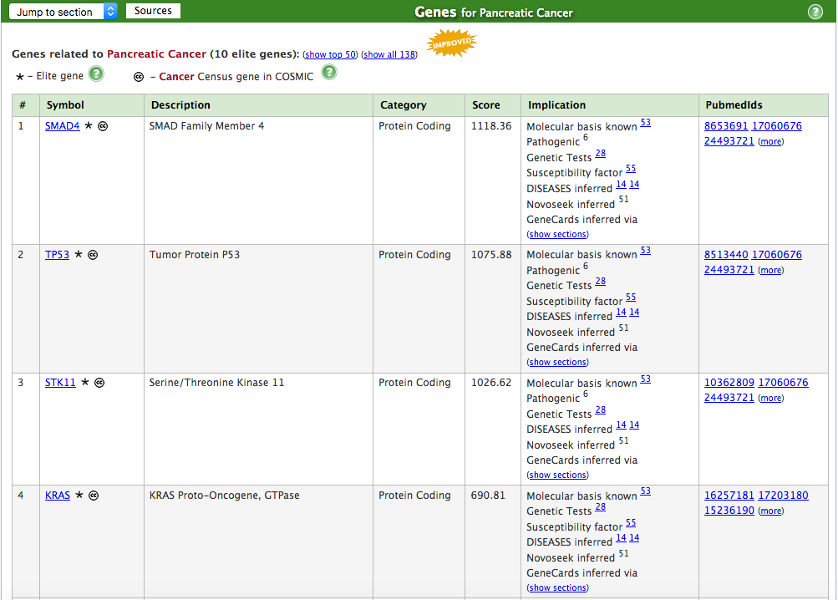

Slide 41
Similarity between GSEA & MalaCards ranking
Sum over all gene sets
Σ w(i) S_{d}(i) = X
➔ Theoretical optimum X_{opt} :
GSEA ranking is identical to MalaCards ranking
➔ Ratio X / X_{Opt} :
Comparison between datasets (MalaCards scores scale differently!)
Weight (GSEA ranking)
Relevance score (MalaCards ranking)
41

